Slide 1
Project Scope, Limitations & Deliverables
REQUIREMENTS
The final SRS defines what is included and what remains outside scope.
In scope
Out of scope
Key limitations
User/role management • digital prescriptions • dispensing • inventory • reminders/alerts • reports • security/audit.
Payment gateways • physical lab/medical-device integration • native desktop app • full EHR • insurance claims • hospital admission • laboratory result management.
Network dependency • third-party email/SMS dependency • concurrent database contention • human input errors • performance variability • security cannot be guaranteed absolutely.
Deliverables
SRS requirements, database design, ERD, architecture, UI/UX wireframes, prototype, test plan/cases/data/results and deployment lifecycle artifacts.
Presenter: Kunjan Tamang
6

Slide 2
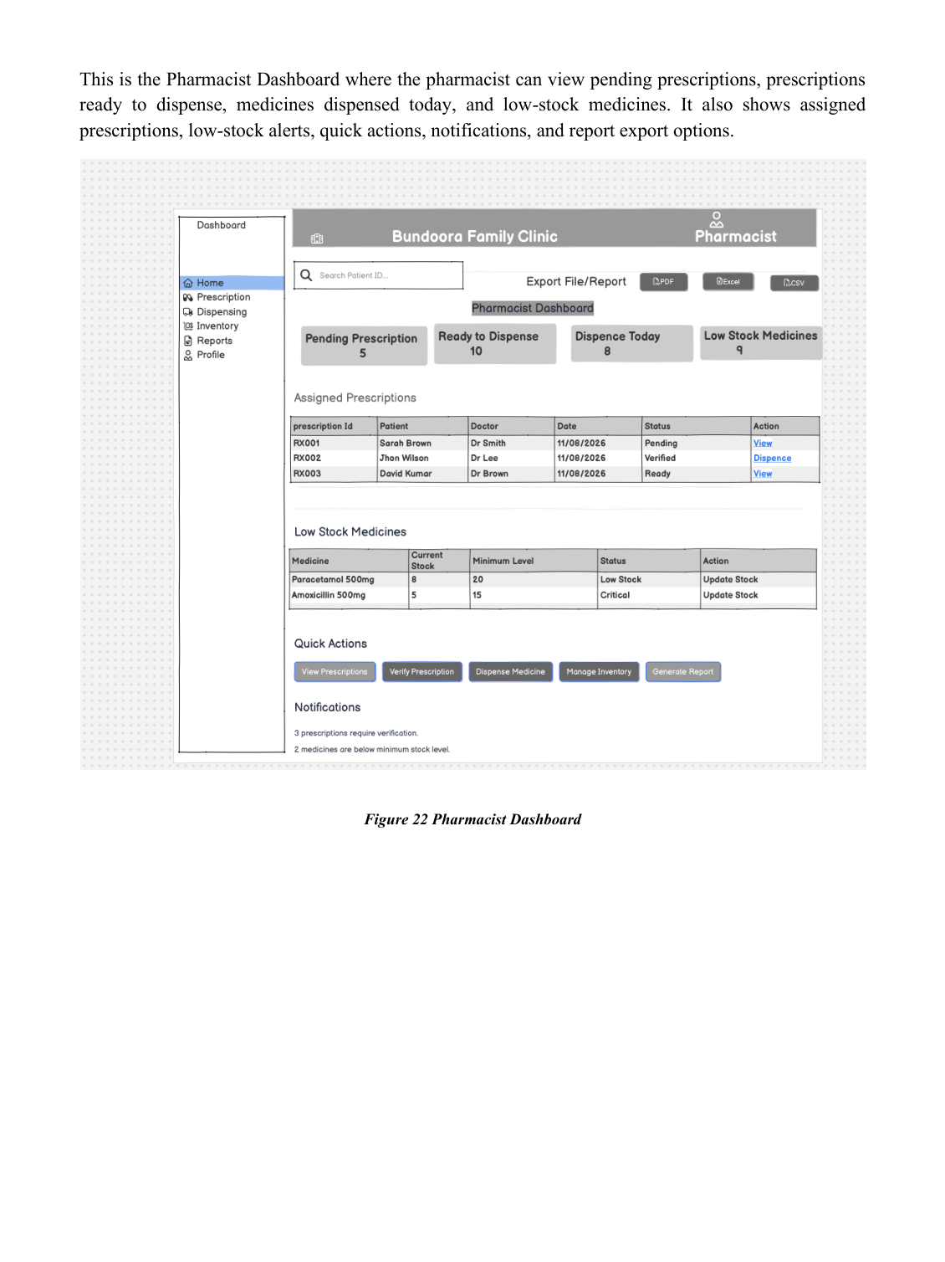
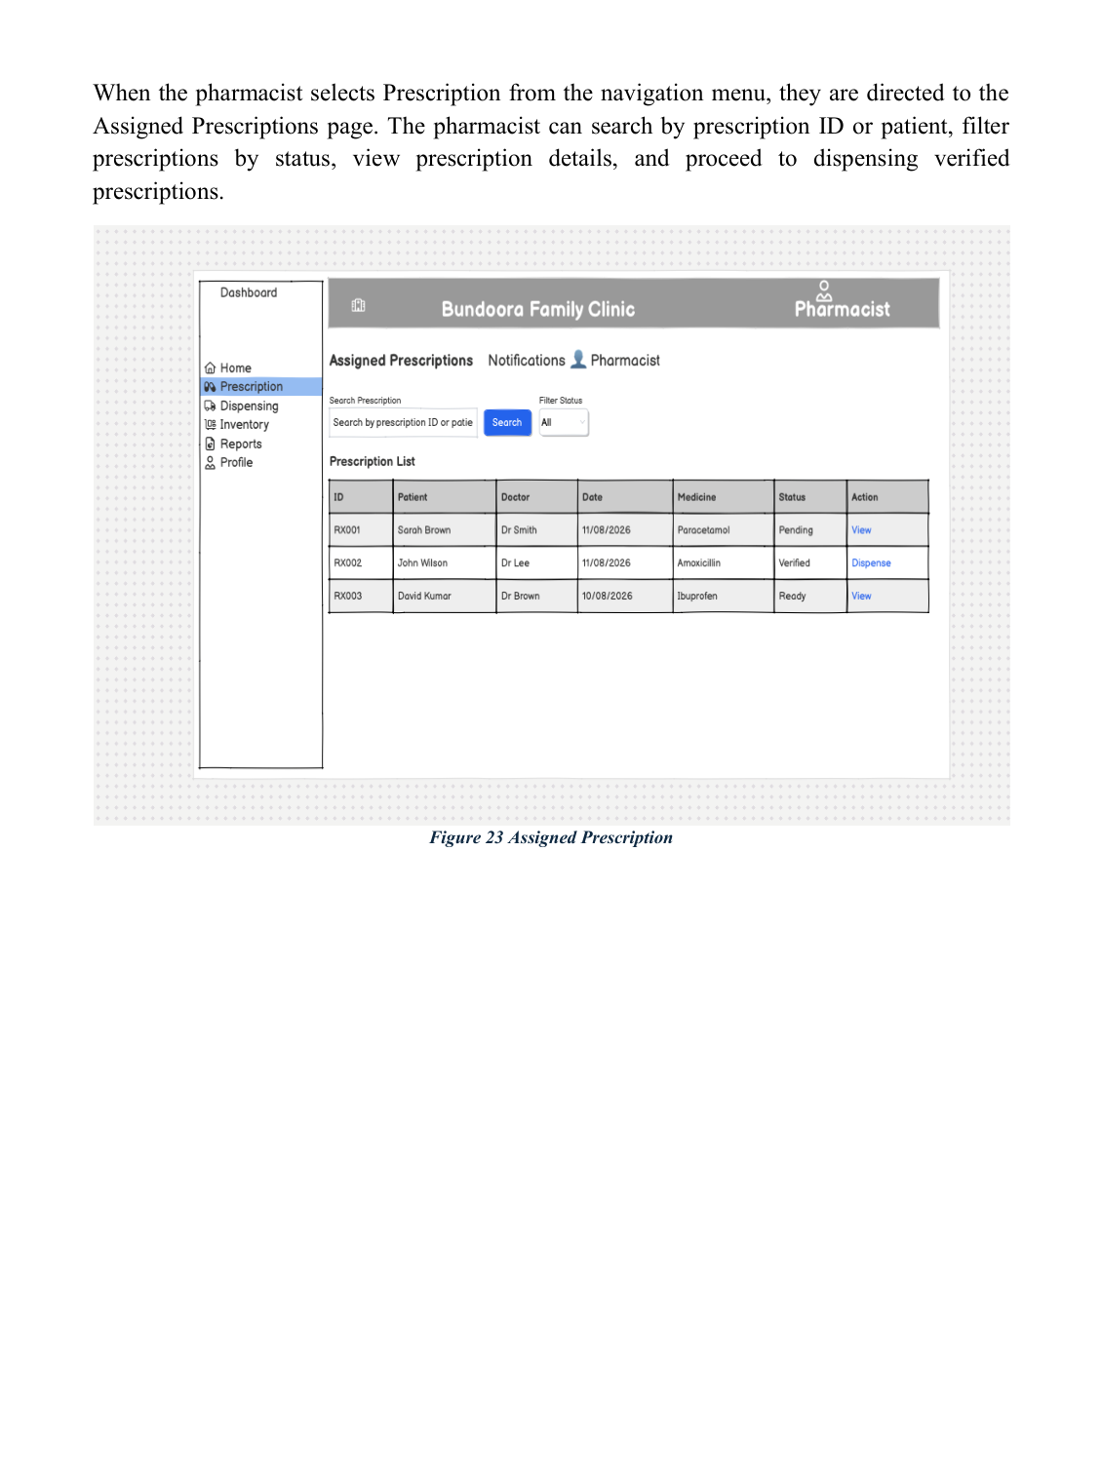
UI Showcase — Pharmacist Dashboard & Assigned Prescriptions
UI / PHARMACIST
Role-based interface screens reproduced from the final SRS report.
Figure/page Pharmacist Dashboard
Figure/page Assigned Prescriptions
Presenter: Yam Bahadur Mohatra
25

Slide 3
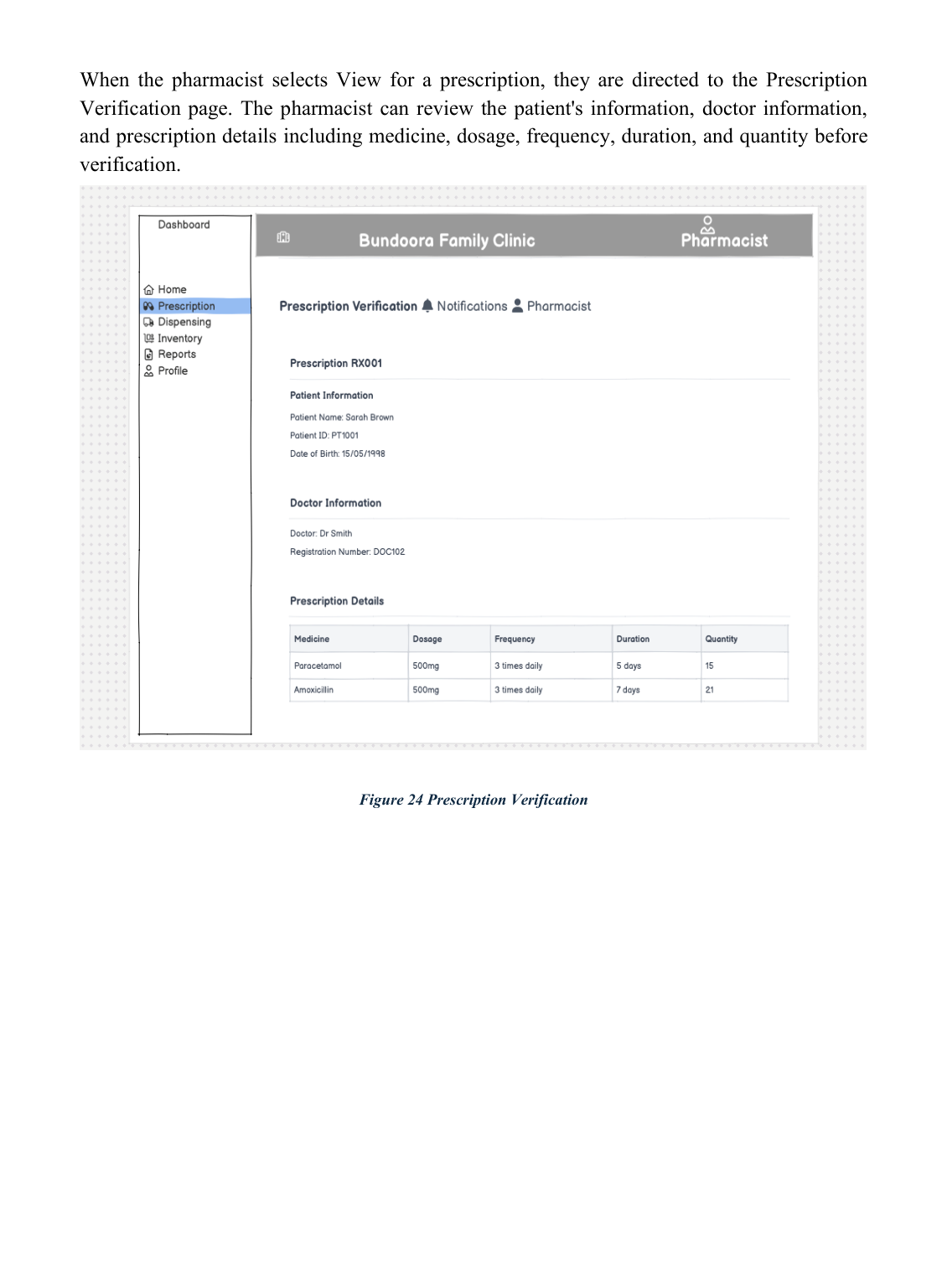
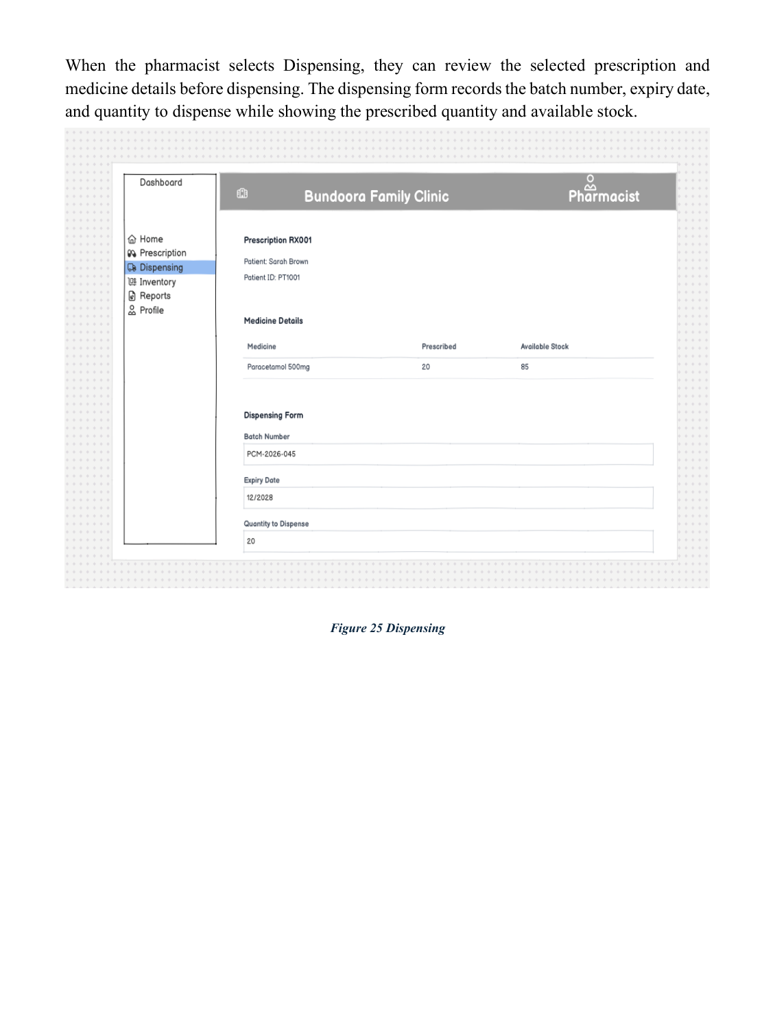
UI Showcase — Prescription Verification & Dispensing
UI / PHARMACIST
Role-based interface screens reproduced from the final SRS report.
Figure/page Prescription Verification
Figure/page Dispensing
Presenter: Yam Bahadur Mohatra
26

Slide 4
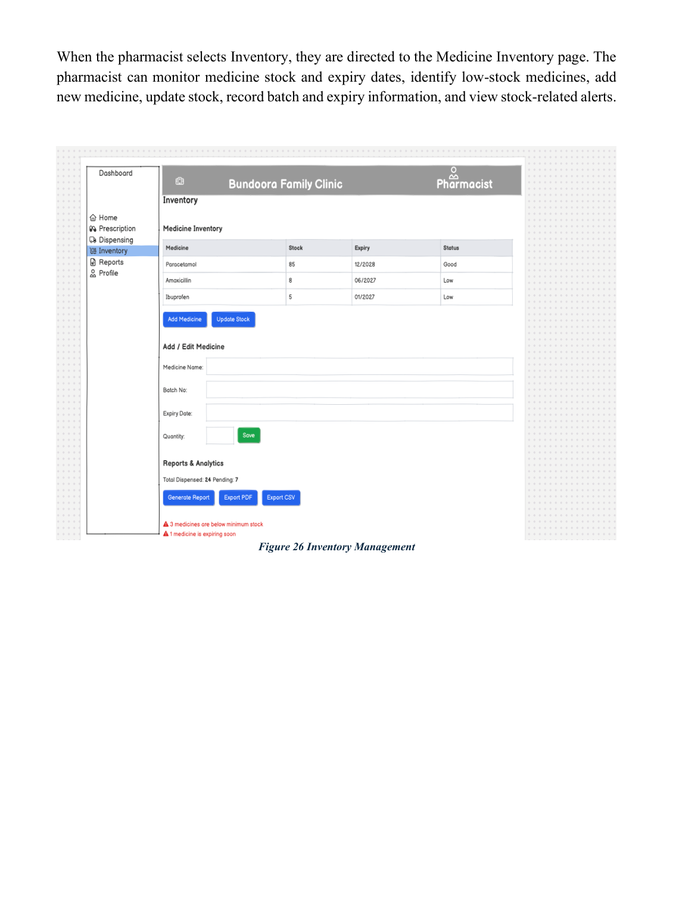
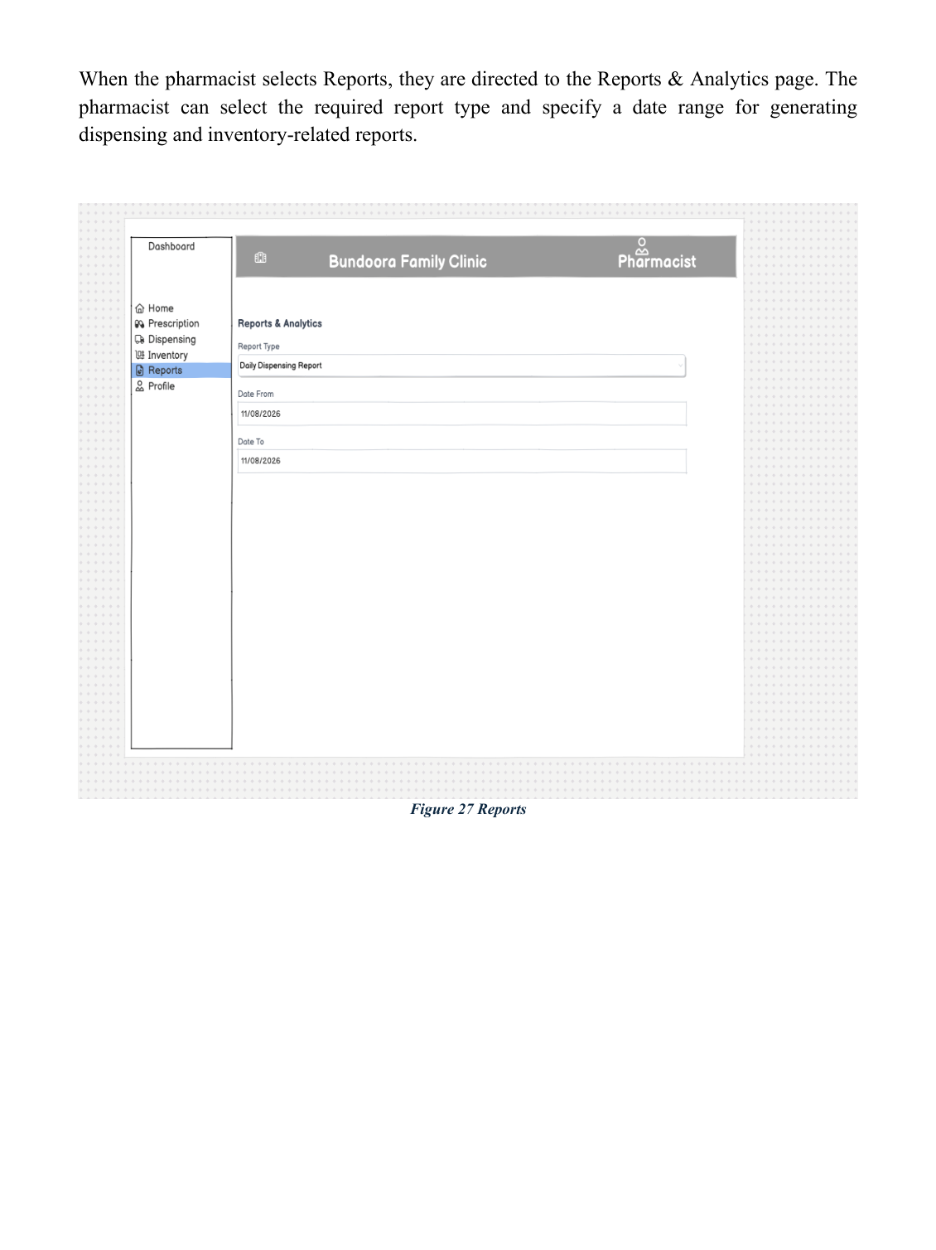
UI Showcase — Pharmacist Inventory & Pharmacist Reports
UI / PHARMACIST
Role-based interface screens reproduced from the final SRS report.
Figure/page Pharmacist Inventory
Figure/page Pharmacist Reports
Presenter: Yam Bahadur Mohatra
27

Slide 5
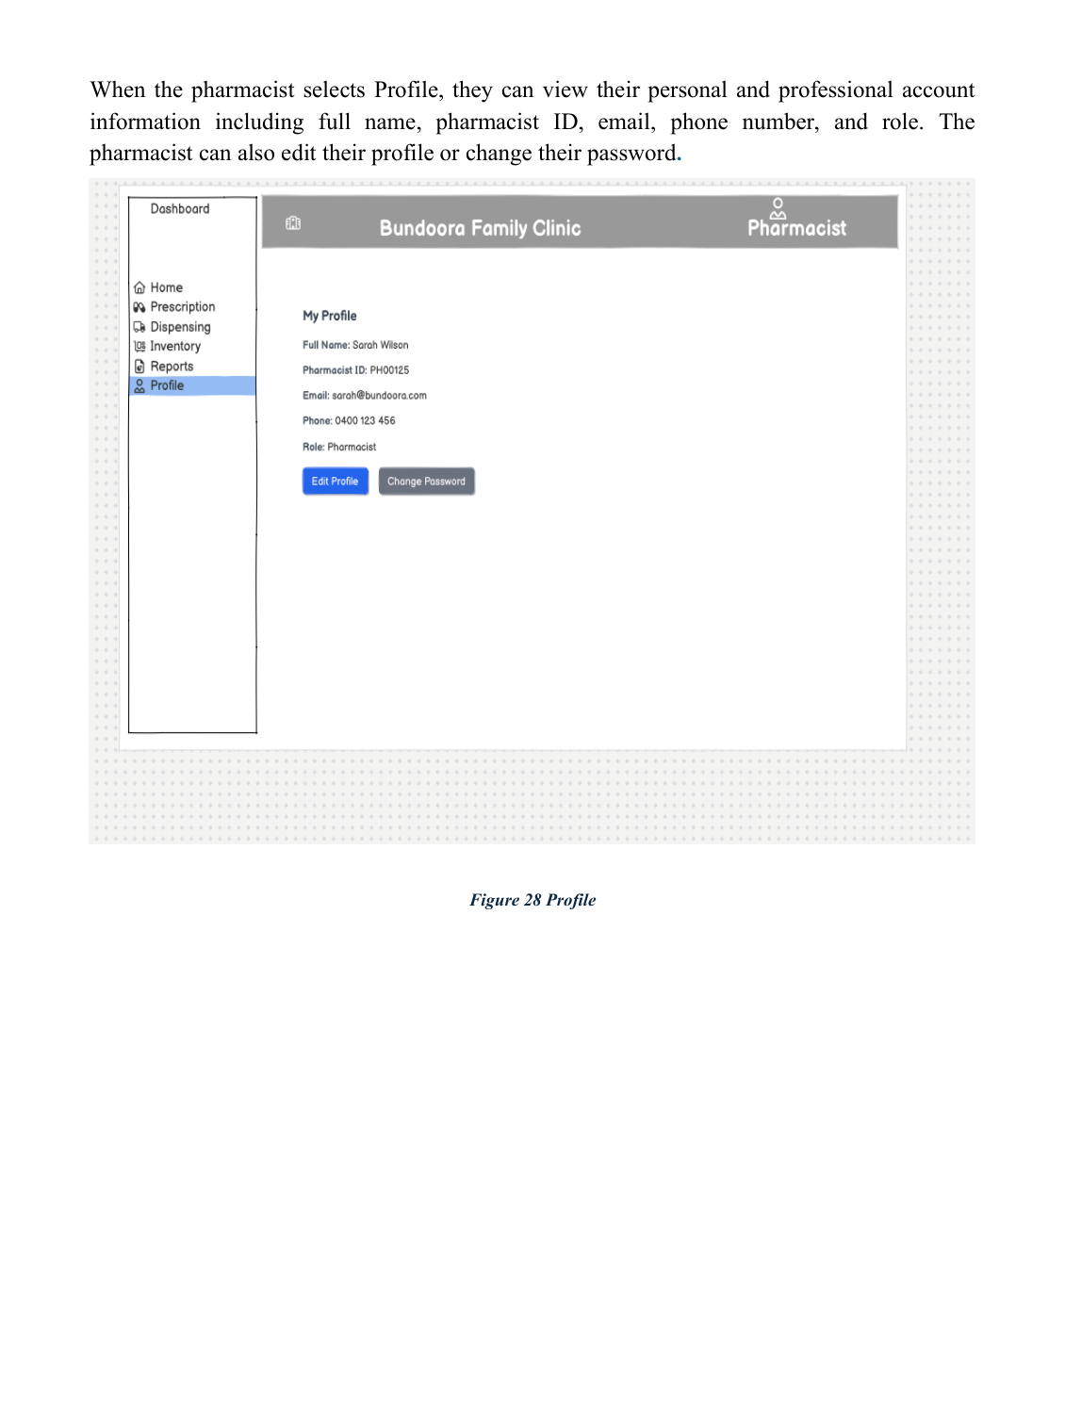
UI Showcase — Pharmacist Profile
UI / PHARMACIST
Role-based interface screens reproduced from the final SRS report.
Presenter: Yam Bahadur Mohatra
28

Slide 6
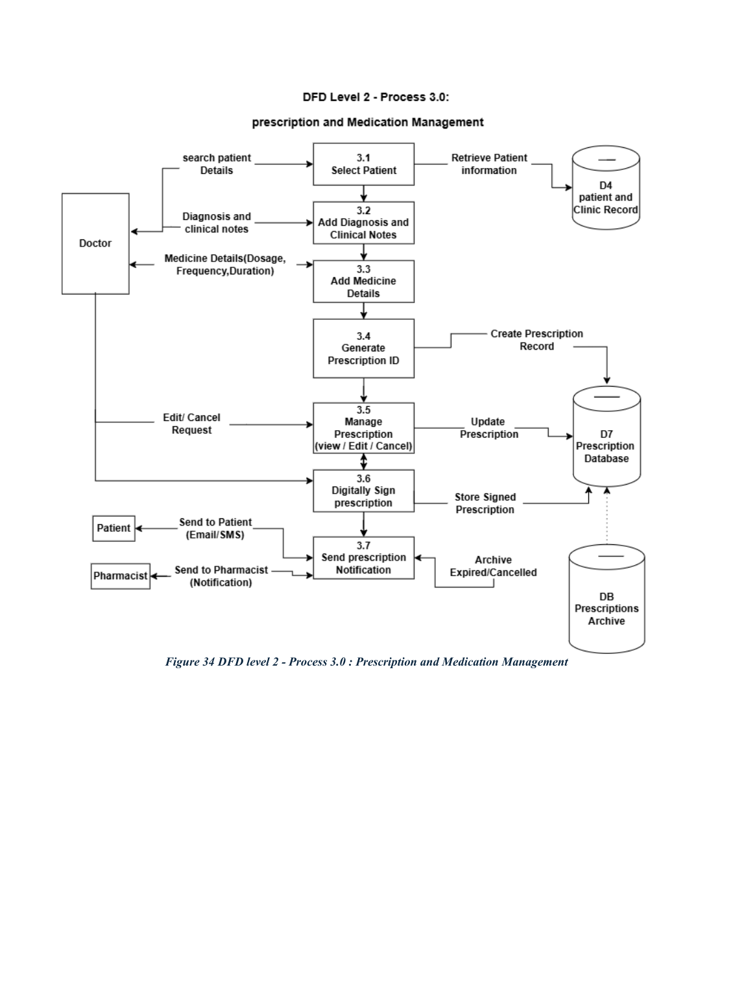
DFD Level 2 — Prescription & Medication
SYSTEM MODELS
Process 3.0 covers patient selection, clinical notes, medicine details, signing, storage and notification.
Presenter: Yam Bahadur Mohatra
33

Slide 7
Data Dictionary — Database Structure
DATA DESIGN
The report defines table fields, data types, keys and descriptions; PK = primary key, FK = foreign key, UQ = unique field.
Identity & access
People
Prescription domain
Roles, Users and User_Roles define accounts and role assignments.
Patients, Doctors and Pharmacists store role-specific information linked to user accounts.
Prescriptions and Prescription_Items connect doctors, patients and medicines with dosage/frequency/duration/quantity.
Inventory & dispensing
Tracking & notifications
Operations & audit
Inventory_Batches, Dispensings and Dispensing_Items track stock, batch usage and quantities dispensed.
Medication_Tracking records Taken/Missed status; Notifications manages reminders, refill, low-stock and expiry messages.
Appointments, Tests, Reports and Audit_Logs support clinic workflows, exports and accountability.
The report's dictionary spans the database model from Roles/Users through Audit_Logs and includes PK/FK/UQ relationships.
Presenter: Utsav Paudel
38

